Slide 1
Window Bangers
Group 9
Thomas McCarthy (Designer)
Jayden Murray (Designer)
Cristian Hanganu (Programmer)

Slide 2
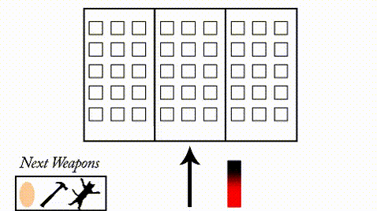
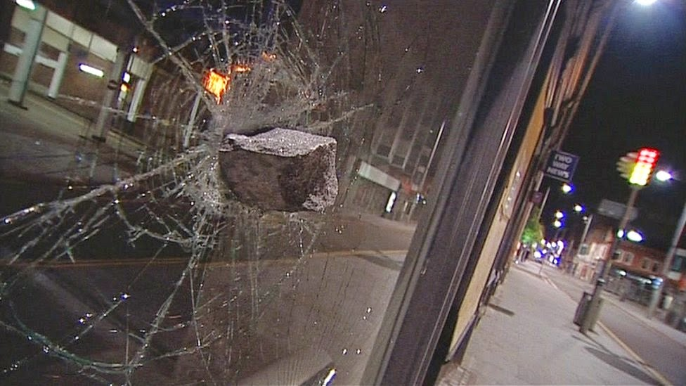

Genre/ Style’s
Competitive 2 Players
2D Destruction
Comedic Components
Notes:
Game Idea

Slide 3
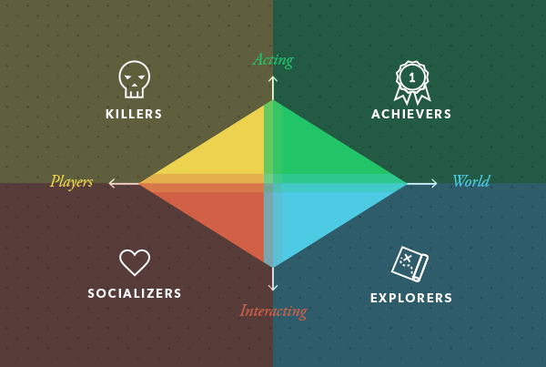
Target Demographic
Gender:
Males
Age:
13+
Achiever:
Interaction with in game-world
Notes:
Acting on the world and achieve breaking all the windows and win

Slide 4
Mechanics
Can mark windows with eggs
Arrow direction and power bar to shoot
Score
Events to give players extra points
Turn taking
Notes:
What they are

Slide 5
Game Flow
Symmetrical Gameplay
Players take turns to throw objects through residents windows.
Not every brick will go through a window.
Events will take place, which will offer bonus points.
Players tap to select an angle and then tap again for power.
Player with the most points after all windows smashed
Notes:
How its played

Slide 6
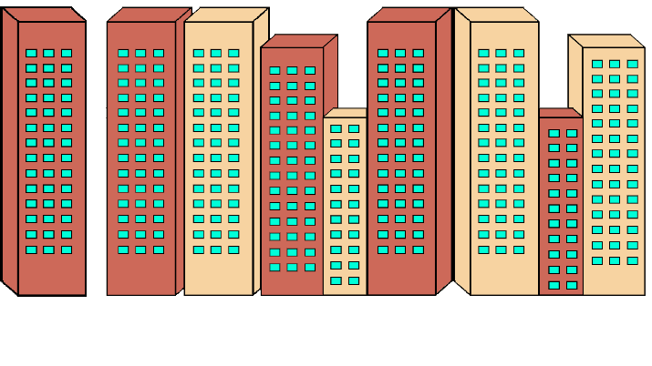
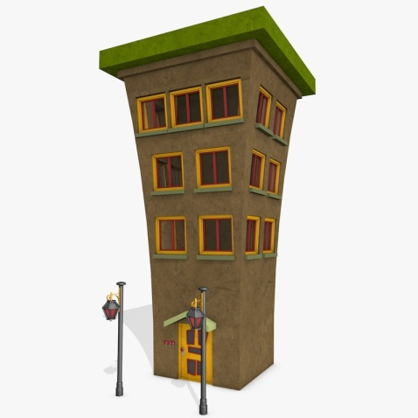

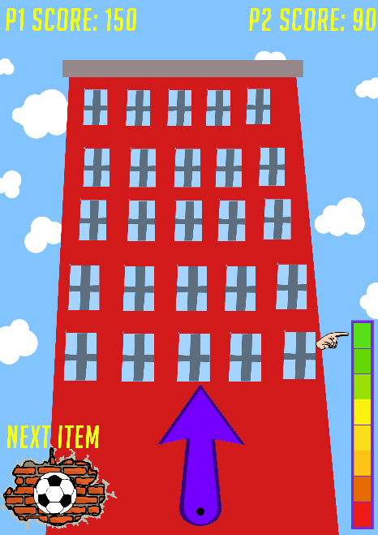
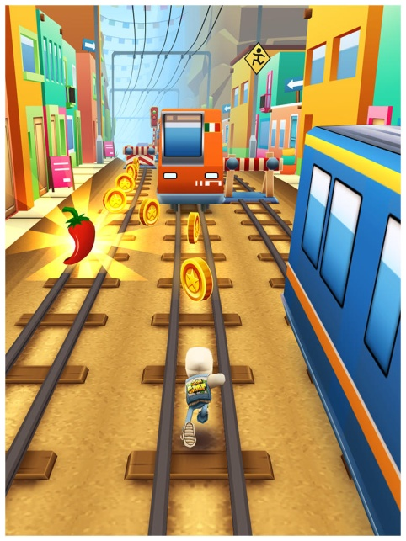

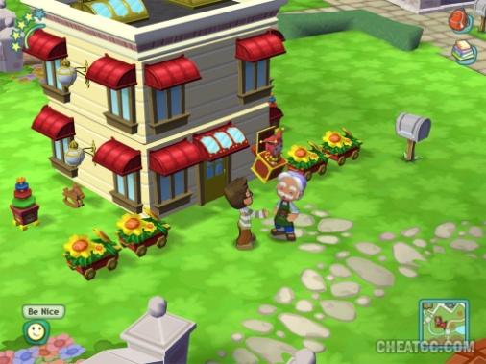
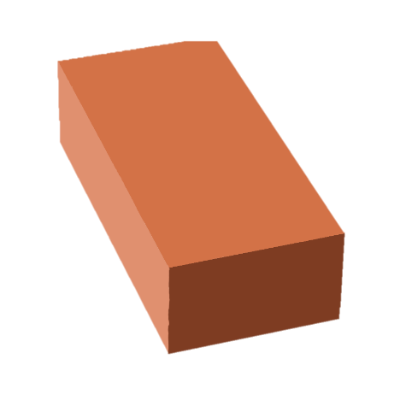

Art
Notes:
The art we are going for and what we have

Slide 7
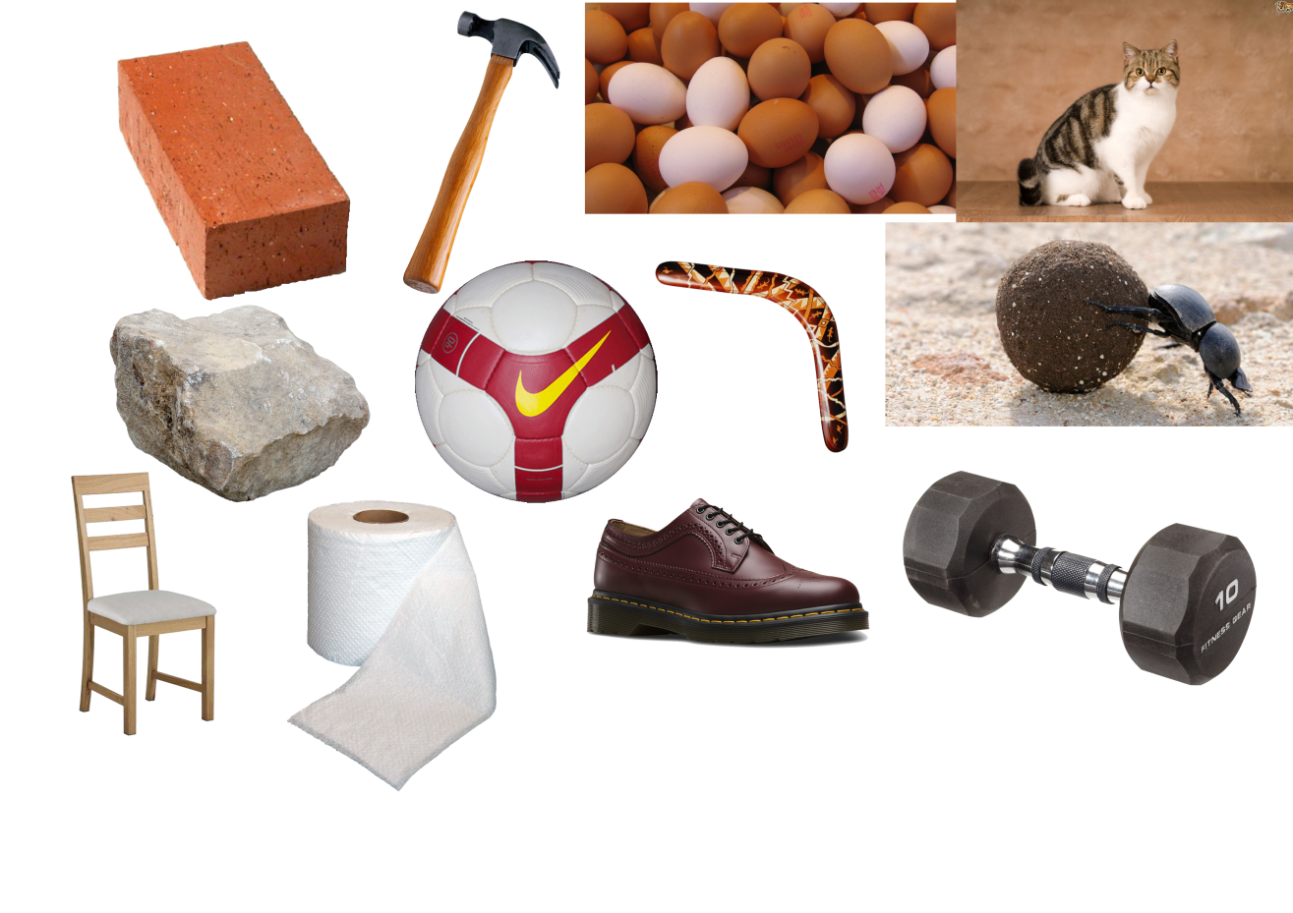
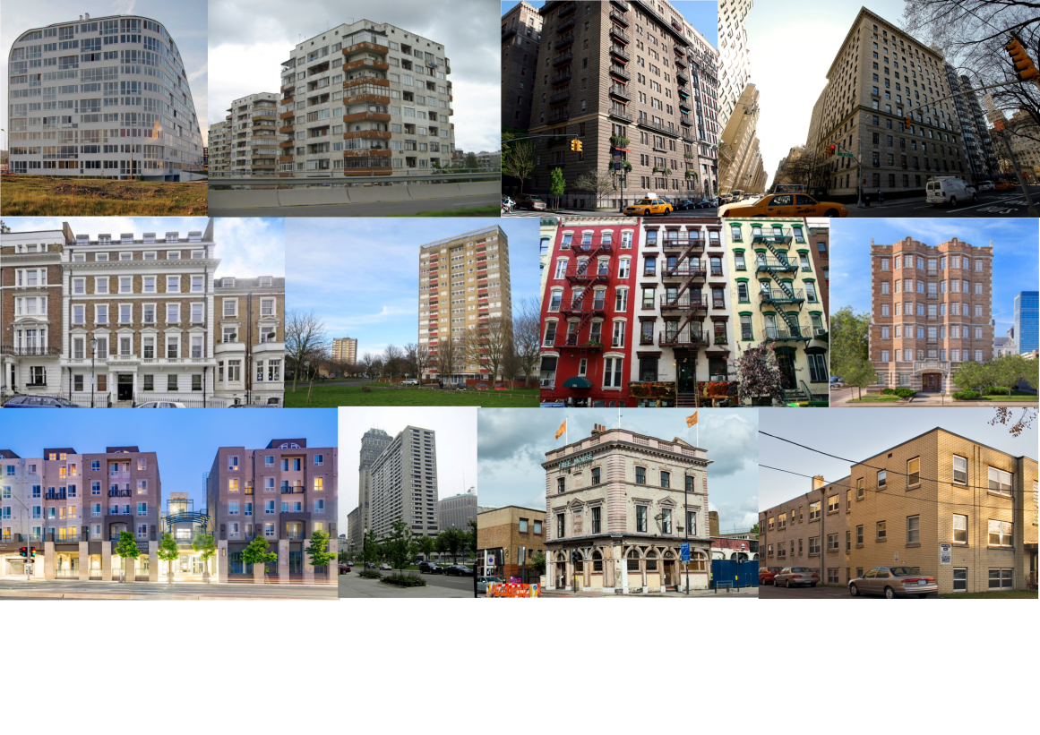
Mood Boards
Notes:
Left Board: This board is showing a variety of different items that can be used in the game to smash the windows and they all vary in weight and size going from toilet roll and shoes to Dumbells and chairs. I was thinking that these could be implemented into the game as options for players to pick from that would make it harder to throw or easier to throw depending on the item. Some items might even score bonus points if thrown at a window before another one (For example, throwing an egg at a window will “mark it” and smashing that window on your next turn would give you bonus points.
Right Board: This board is all different types of apartment blocks, I tried to look for apartments that have a lot of windows and also vary in location. The change in Windows would make the games difficulty also change since there would be more or less targets depending on the type of building chosen by the players. The location could also be good to look into as certain players might enjoy playing in locations that they find familiar such as London or New York.

Slide 8
Any Questions?

